Slide 1
VRIJE UNIVERSITEIT BRUSSEL
MASTERS IN APPLIED COMPUTER SCIENCE
TECHNIQUES OF ARTIFICIAL INTELLIGENCE
PERFORMANCE EVALUATION OF SUPPORT VECTOR MACHINE AND DECISION TREE ALGORITHMS FOR BREAST CANCER PREDICTION
LECTURER : GERAINT WIGGINS
TEACHING ASSISTANT : ISEL DEL CARMEN GRAU GRACIA
PRESENTED BY : ABHISHEIK KRISHNAGIRI TUPIL RAVIKANTH - 0575002

Slide 2
INDEX
GOAL OF THE PROJECT
DATA SET
ALGORITHMS USED
COMPARISION METRICES
CROSS VALIDATION
CONCLUSION
REFERENCE

Slide 3
GOAL OF PROJECT
I implemented two algorithms Support Vector Machine (SVM) and Decision Tree (ID3) on two datasets Breast Cancer Coimbra Dataset(BCCD) and Wisconsin Breast Cancer Dataset(WBCD) and compare them based on the performance and concluded which algorithm is better for each of the dataset. This is a classification-based problem , where we are classifying if a person is healthy or not in the first dataset(BCCD) and if the person has benign or malignant tumor in the second dataset(WBCD).
Notes:
So, the main idea of the project is to find if a person is healthy or not with the BCCD dataset and to find whether the person has benign or malignant tumor with the WBCD dataset. In both the cases we are arriving only at two solutions , that is either health or not healthy and either benign or malignant , so this is basically a classification-based problem. We will be using two algorithms that is Support Vector Machine and Decision Tree.
On implementing the algorithm, it will provide us with the metrices by which we will be able to evaluate the performance of the models.

Slide 4
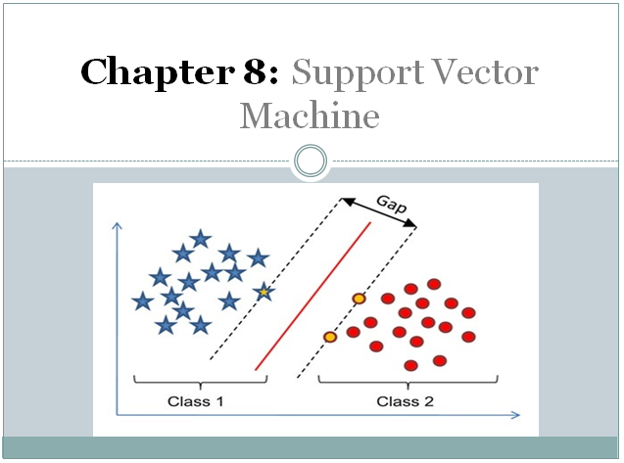
ALGORITHMS USED
SUPPORT VECTOR MACHINE ALGORITHM (SVM)
SVM (Support Vector Machine) is a supervised machine learning algorithm that can be used to solve classification and regression problems. It is, however, mostly used to solve classification problems. Each data object is plotted as a point in n-dimensional space (where n is the number of features you have), with the value of each function being the value of a certain coordinate in the SVM algorithm. Then we conduct classification by locating the hyper-plane that clearly distinguishes the two types.
Notes:
Create a hyperplane that separates the dataset into classes
According to SVM, we have to find the points that lie closest to both the classes. These points are known as support vectors. In the next step, we find the proximity between our dividing plane and the support vectors. The aim of an SVM algorithm is to maximize this very margin. When the margin reaches its maximum, the hyperplane becomes the optimal one.

Slide 5
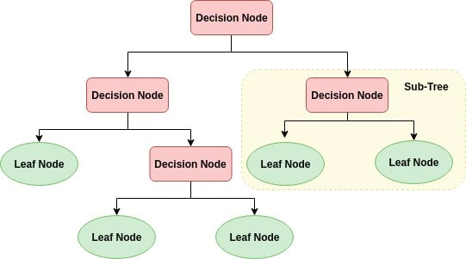
ALGORITHMS USED
DECISION TREE ALGORITHM (ID3)
A decision tree is a type of machine learning algorithm that divides data into groups. Partitioning begins with a binary split and proceeds until no further splits are possible. Various branches of varying lengths develop. A decision tree's aim is to condense the training data into the shortest possible tree.
Notes:
DT is a prediction model which represents the mapping between object attributes and object values.
The ID3 algorithm builds decision trees using a top-down greedy search approach through the space of possible branches . A greedy algorithm, as the name suggests, always makes the choice that seems to be the best at that moment.
Steps in ID3 algorithm:
It begins with the original set S as the root node.
On each iteration of the algorithm, it iterates through the set S and calculates Entropy(H) .
It then selects the attribute which has the smallest Entropy or Largest Information gain.
The set S is then split by the selected attribute to produce a subset of the data.
The algorithm continues to recur on each subset, considering only attributes which were never selected before.

Slide 6
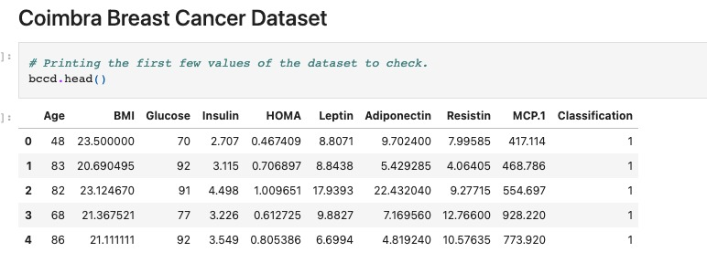
DATA SET
BCCD: Breast Cancer Coimbra Dataset. The BCCD data is made up of 116 instances, each with ten attributes. The dependent attribute is classification, which is represented as an integer between 1 and 2, with 1 representing healthy controls and 2 representing patients.
The link for the dataset : https://archive.ics.uci.edu/ml/machine-learning-databases/00451/
Notes:
Talk about the dataset like its attributes and features.
Correlation Matrix : . On a dataset with many attributes, the set of correlation values between pairs of its attributes form a matrix which is called a correlation matrix.
Train Test Split : The train-test split is a technique for evaluating the performance of a machine learning algorithm. The procedure involves taking a dataset and dividing it into two subsets. The first subset is used to fit the model and is referred to as the training dataset. The second subset is not used to train the model; instead, the input element of the dataset is provided to the model, then predictions are made and compared to the expected values. This second dataset is referred to as the test dataset.
Data bias is a type of error in which certain elements of a dataset are more heavily weighted or represented than others. A biased dataset does not accurately represent a model's use case, resulting in skewed outcomes. To overcome this scaling of the data is done.
For example, In Support Vector Machine tries to maximize the distance between the separating plane and the support vectors. If one feature has very large values, it will dominate over other features when calculating the distance. So Standardization gives all features the same influence on the distance metric.
Standardization: Standardization is the concept and step of putting different variables on the same scale. This concept allows comparing scores between different types of variables.
The main idea is to standardize i.e. μ (mean)= 0 and σ(standard deviation) = 1 to your features before applying any machine learning model.

Slide 7
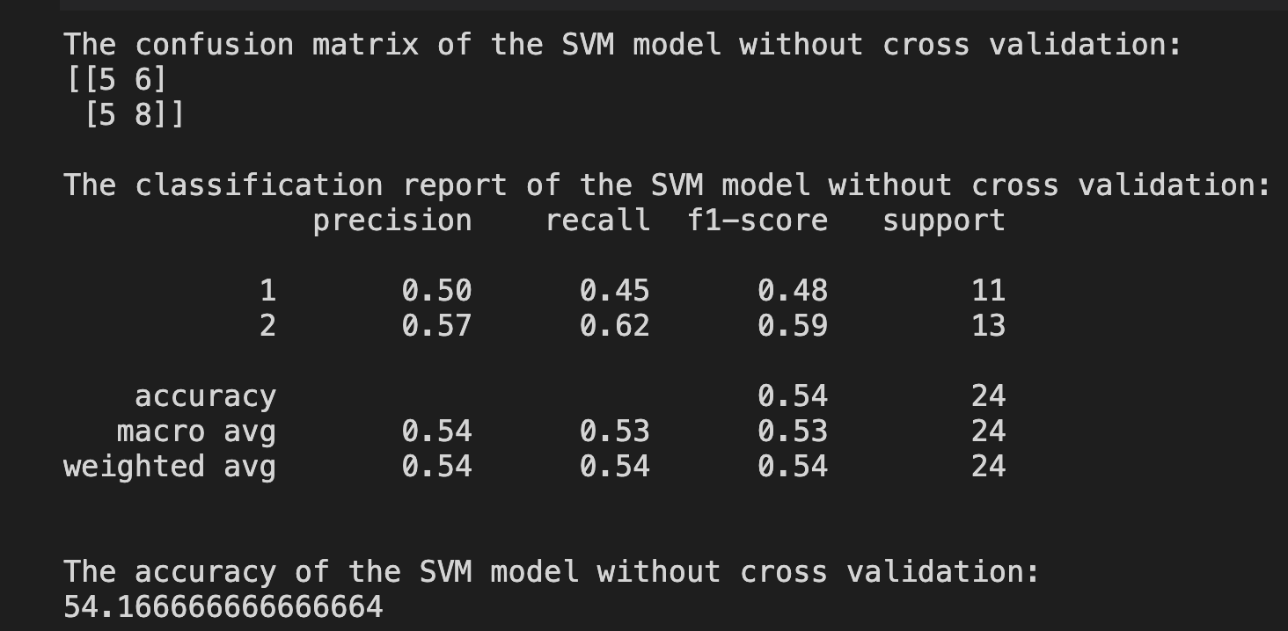
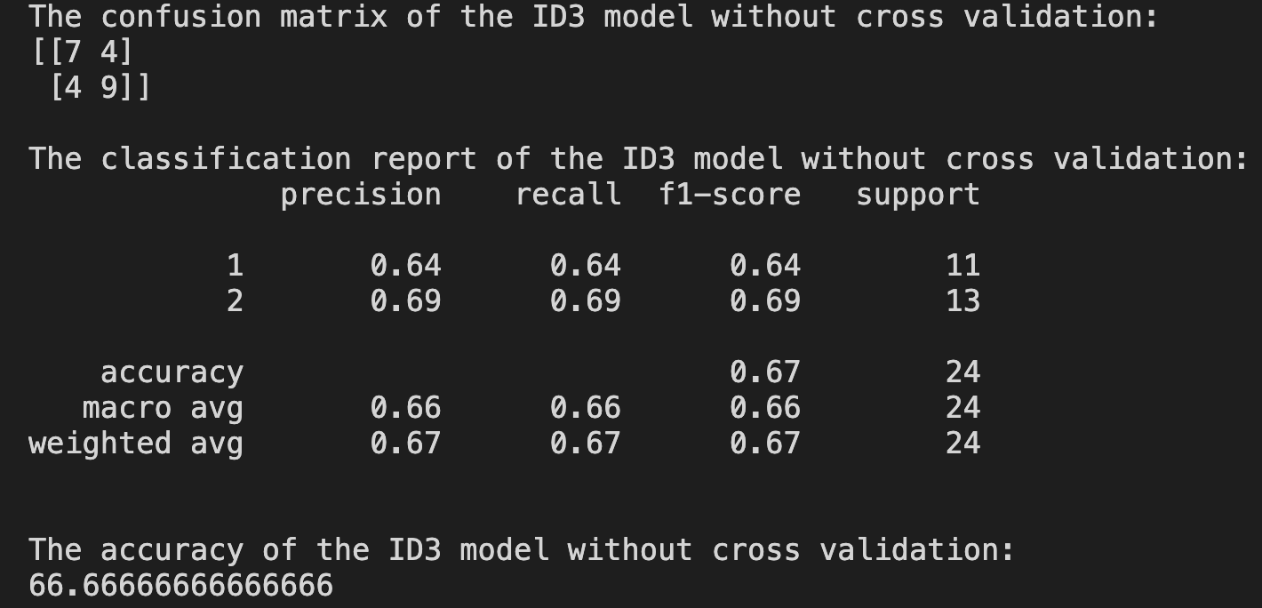
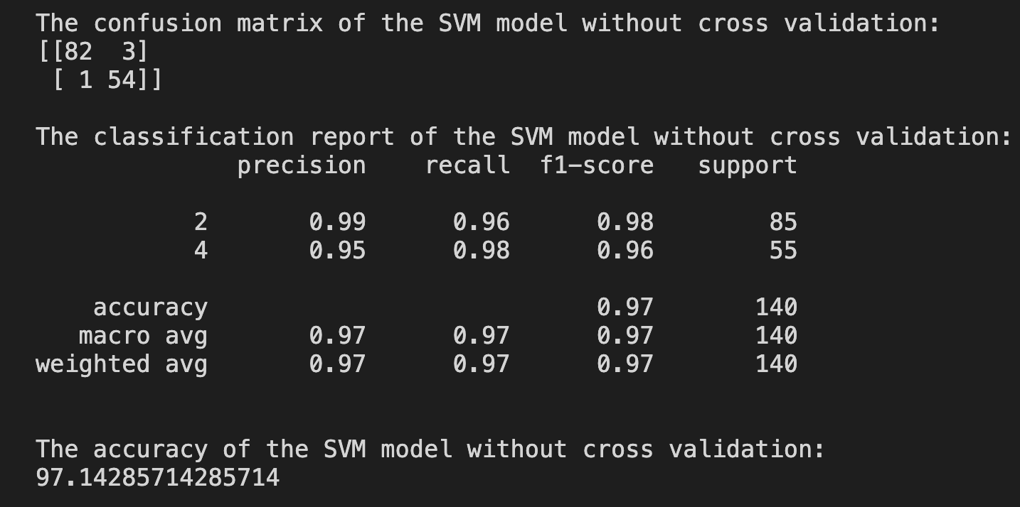
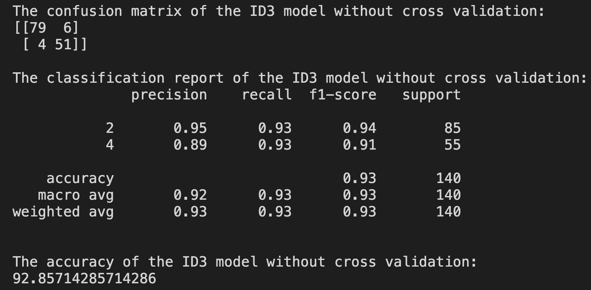
COMPARISON METRICES
SVM Algorithm.
ID3 Algorithm.
BCCD Dataset.
WBCD Dataset.
Notes:
Talk about the model fitting.
(Radial basis function kernel just remember)
Random State simply sets a seed to the random generator, so that your train-test splits are always deterministic. If you don't set a seed, it is different each time.
A confusion matrix is a table that is often used to describe the performance of a classification model (or "classifier") on a set of test data for which the true values are known.
“true positive” for correctly predicted event values.
“false positive” for incorrectly predicted event values.
“true negative” for correctly predicted non-event values.
“false negative” for incorrectly predicted non-event values.
precision (also called positive predictive value) is the fraction of relevant instances among the retrieved instances.
while recall is the fraction of relevant instances that were retrieved.
Both precision and recall are therefore based on relevance. Improvement is based on the F1 score and both recall and precision cannot be improved as one comes at the cost of other.
The score of F-measure metric is the harmonic average of the precision and recall.
The higher F-measure signifies the higher efficiency of the models, where 1 is the best value of F-measure while 0 is the worst.
The support is the number of samples of the true response that lie in that class
Macro Average computes f1 for each label, and returns the average without considering the proportion for each label in the dataset.
Weighted average computes f1 for each label, and returns the average considering the proportion for each label in the dataset.

Slide 8
CROSS VALIDATION.
Shuffle the dataset randomly.
Split the dataset into k groups
For each unique group:
Take the group as a hold out or test data set
Take the remaining groups as a training data set
Fit a model on the training set and evaluate it on the test set
Retain the evaluation score and discard the model
Summarize the skill of the model using the sample of model evaluation scores
Notes:
Test train split there is a chance that there can be overfitting.
Cross-validation is a resampling procedure used to evaluate machine learning models.
The procedure has a single parameter called k that refers to the number of groups/folds that a given data sample is to be split into which in our case is 5 .
It can be used to evaluate the model on unseen data.
It shuffles the data set randomly and splits the dataset into K groups that is 5 in our case.
Take the group as a test data set and the remaining as training data set and the fits into the model and prediction takes place.
Pruning reduces the size of decision trees by removing parts of the tree .Decision trees are the most susceptible out of all the machine learning algorithms to overfitting and effective pruning can reduce this likelihood

Slide 9
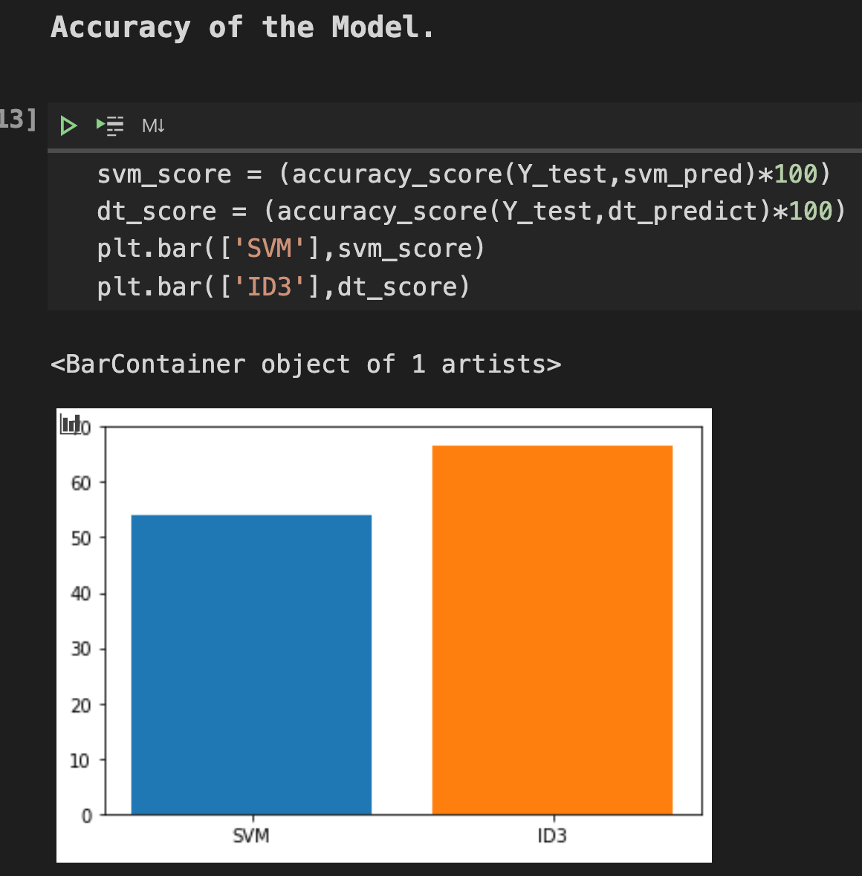
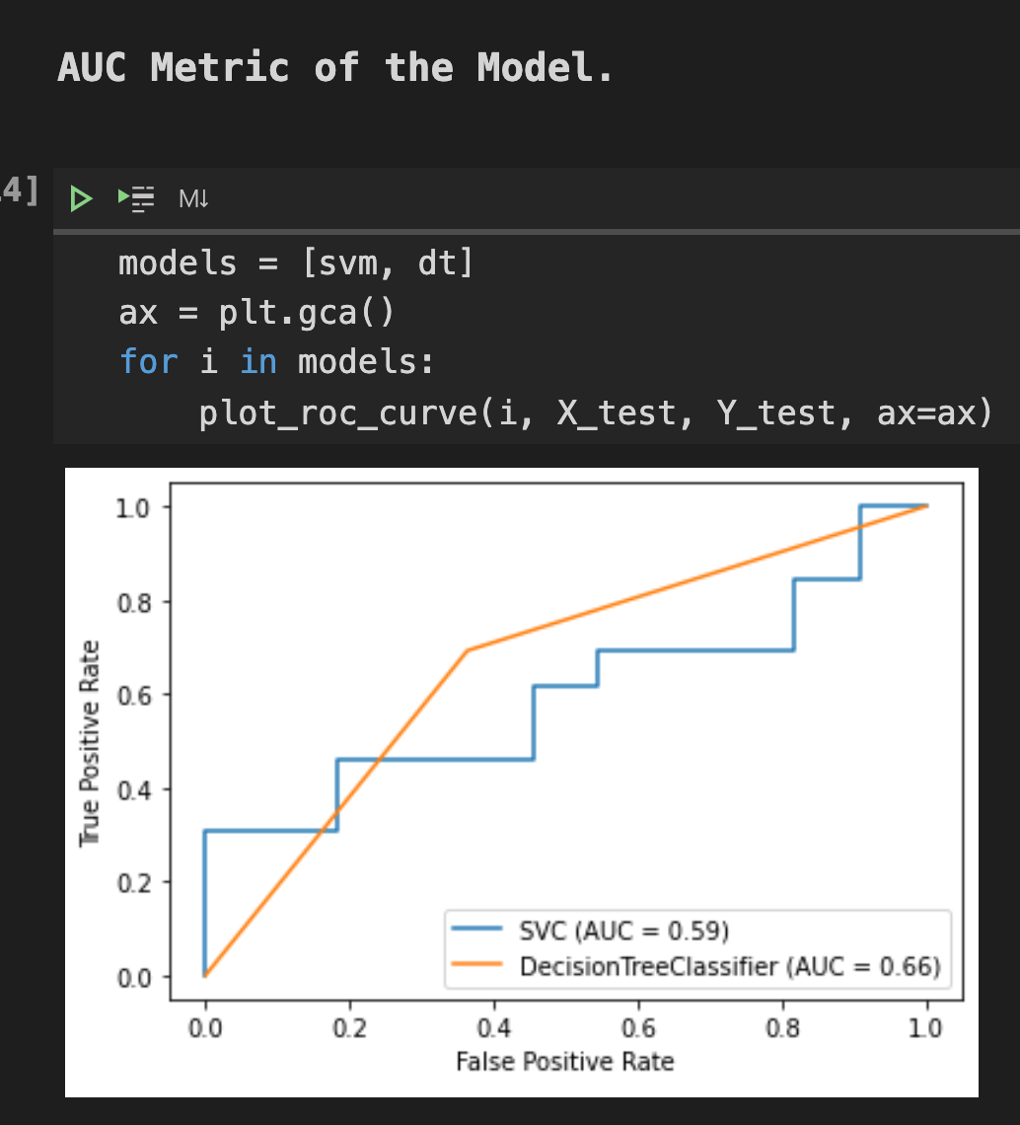
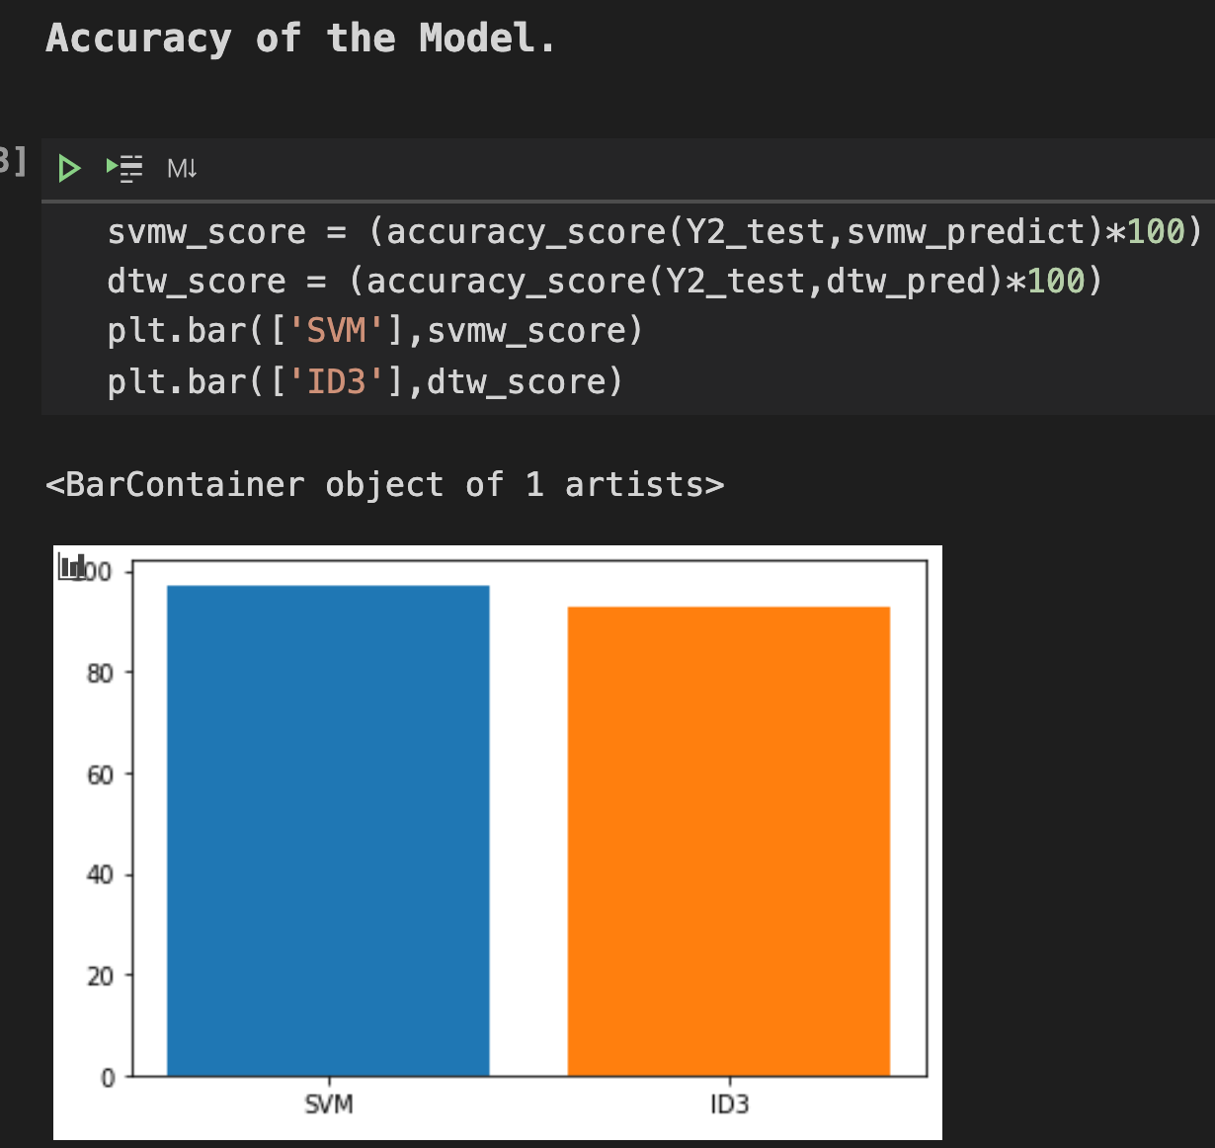
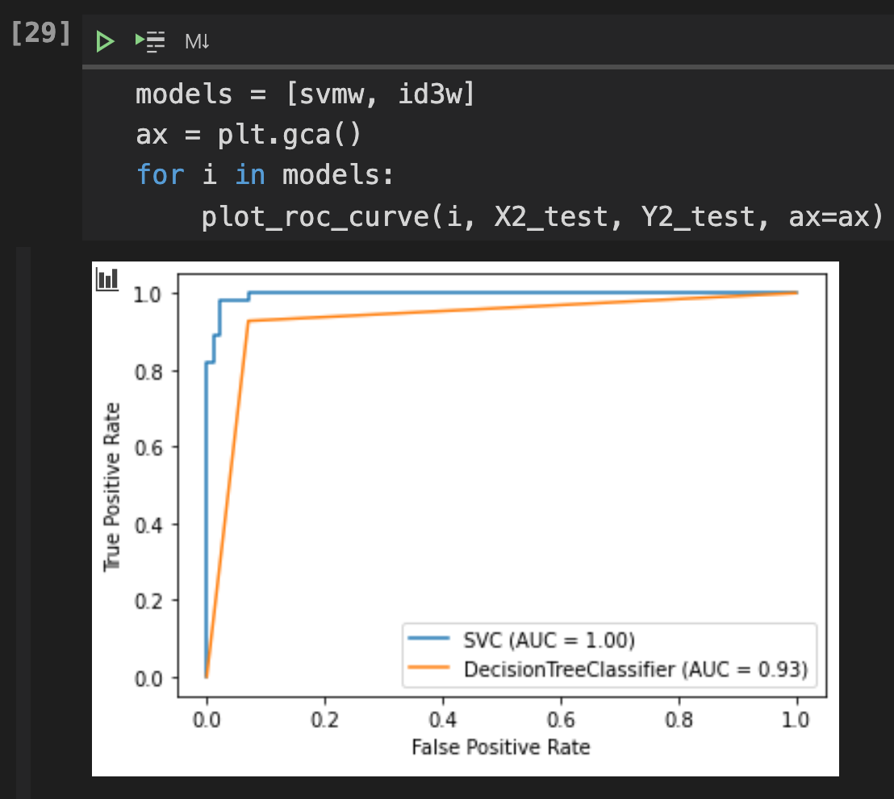
COMPARISON METRICES
Accuracy Score.
AUC Score.
BCCD Dataset.
WBCD Dataset.
Notes:
This study combines accuracy, AUC metric, and F measure metric as the index for choosing the best model.
Accuracy emphasizes on the performance of the classifier, and it calculates the proportion that true positive items occupy among the sum of true positive items and false positive items.
An ROC curve (receiver operating characteristic curve) is a graph showing the performance of a classification model at all classification thresholds. This curve plots two parameters:
True Positive Rate is a synonym for recall
False Positive Rate
The AUC (area under the ROC curve) describe the probability when the prediction of true positive instance is higher than the true negative instance . AUC stands for "Area under the ROC Curve." That is, AUC measures the entire two-dimensional area underneath the entire ROC curve
AUC provides an aggregate measure of performance across all possible classification thresholds. One way of interpreting AUC is as the probability that the model ranks a random positive example more highly than a random negative example

Slide 10
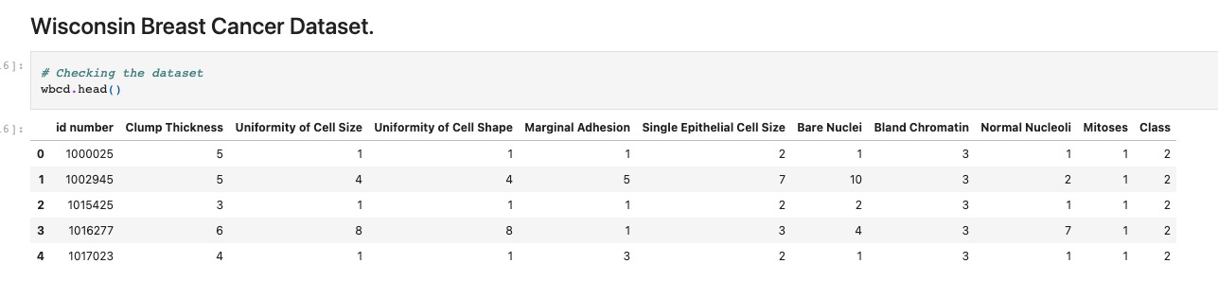
DATA SET
WBCD: Breast Cancer Wisconsin Dataset. There are 699 instances are represented in the WBCD info. The dependent characteristic is class, which is represented by the integers 2 and 4, with 2 indicating benign and 4 indicating malignant.
The link for the dataset: https://archive.ics.uci.edu/ml/machine-learning-databases/breast-cancer-wisconsin/
Notes:
There are 16 instances in the WBCD dataset which contains a single missing attribute value and may also make negative influence to the end result of the experiment. So we are replacing it with 0.

Slide 11
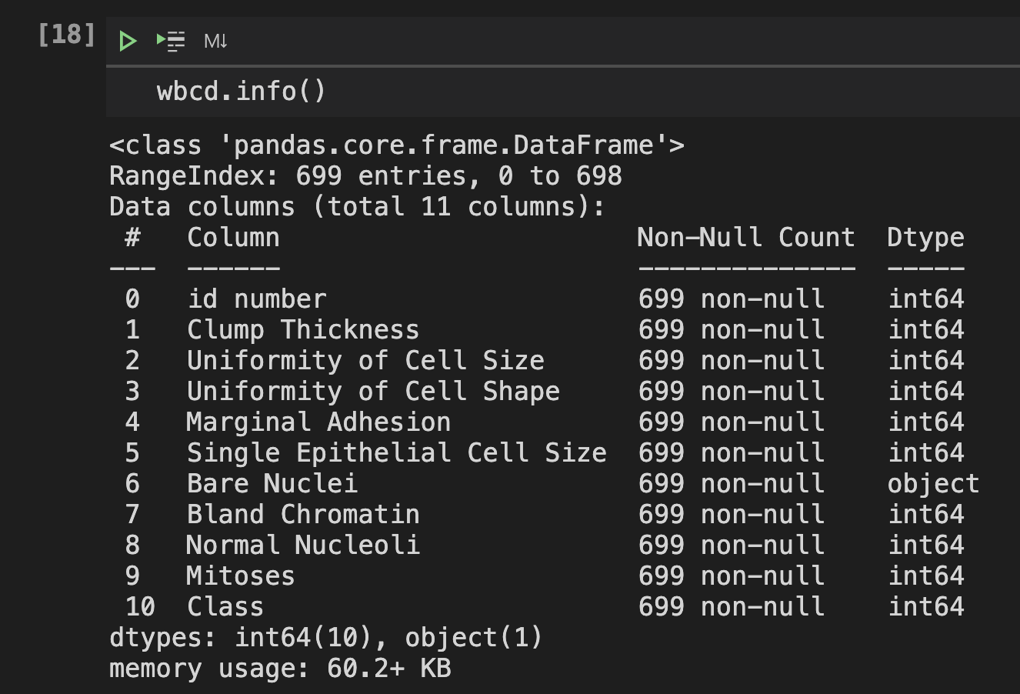
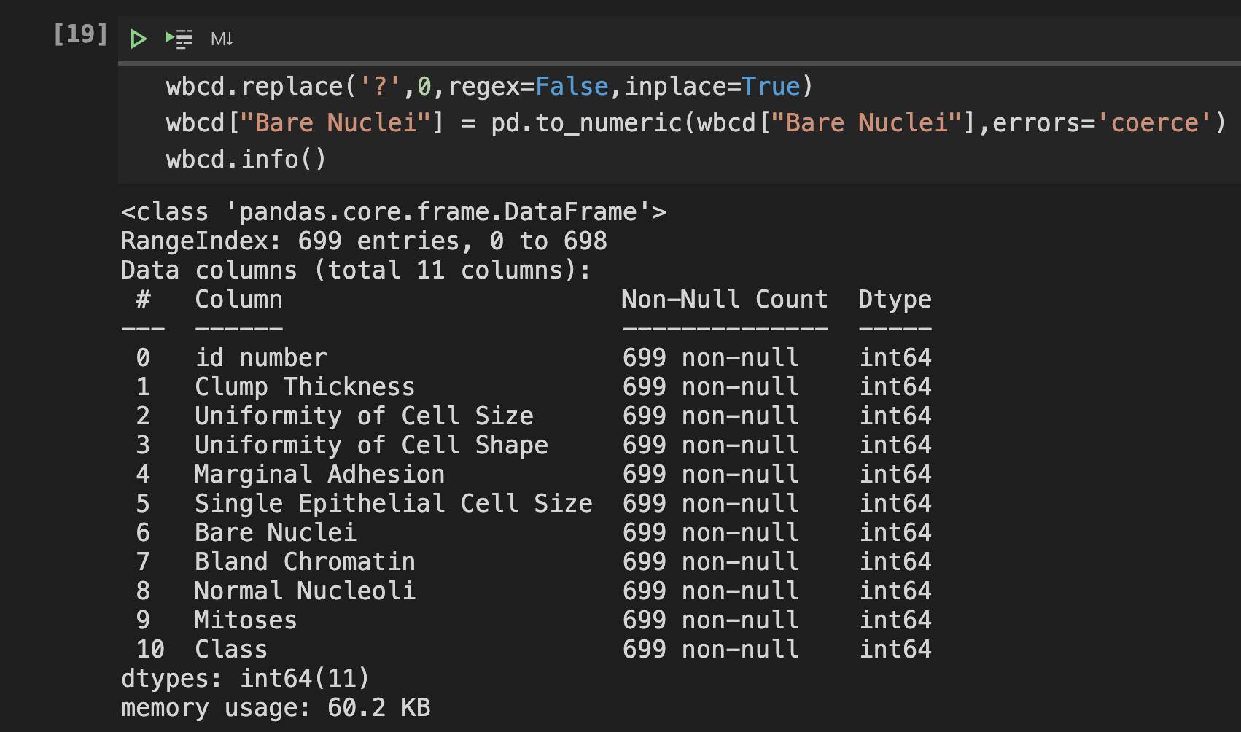
DATA SET
Notes:
Overfitting: Overfitting happens when a model learns the detail and noise in the training data to the extent that it negatively impacts the performance of the model on new data. The problem is that these concepts do not apply to new data and negatively impact the model's ability to generalize

Slide 12
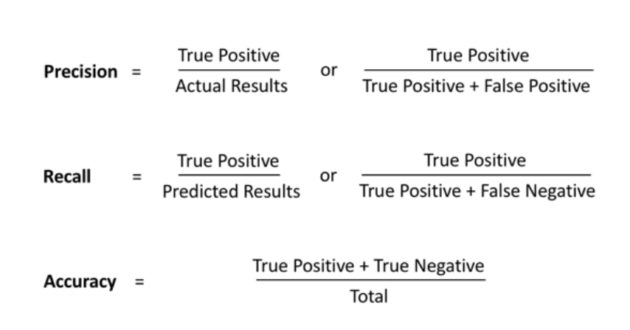
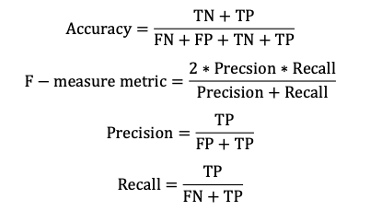

Slide 13
REFERENCE
https://scikitlearn.org/stable/modules/svm.html
https://scikit-learn.org/stable/modules/tree.html
https://matplotlib.org/stable/contents.html
https://datascience.stackexchange.com/questions/54436/valueerror-pos-label-1-is-not-a-valid-label-arrayn-y-dtype-u1
https://stackoverflow.com/questions/56202930/this-svc-instance-is-not-fitted-yet-call-fit-with-appropriate-arguments-befor
Yixuan Li, Zixuan Chen. Performance Evaluation of Machine Learning Methods for Breast Cancer Prediction. Applied and Computational Mathematics. Vol. 7, No. 4, 2018, pp. 212-216. doi: 10.11648/j.acm.20180704.15

